Slide 1
Pexip Overview – SaaS/Hybrid, Infinity, PPC
2024

Slide 2



Security & Compliance
Pexip builds solutions with a security-first mentality and continues to specialize in highly-regulated verticals due to a world class security posture.
ISO27001
SSAE16
SOC2
Data Encrypted at rest and in transit
Access restriction features
Published Resources Include:
Security Bulletin
Best Practices (Infinity)
Privacy Policy (Service)
JITC
COMPLIANT

Slide 3









Pexip as the core technology
Virtualized
Distributed
Intelligent
Customizable
Entirely virtualized using cloud native APIs including cloud bursting. Runs in private data center (on-premises) or in public clouds such as AWS, Azure and others
Designed following modern IT fundamentals, Infinity is a cloud agnostic distributed system that scales resources according to usage and geography
Utilizes smart scaling and data routing for efficient data processing and intelligent transcoding of media to allow for the best experience independent of connection, technology and device
Easy configuration, monitoring and troubleshooting provides IT team total control of the network and data. Easily customized to the company’s look and API, to be adopted to a business specific workflow
GCP
Government

Slide 4




Pexip | Flexible Deployment Options
Customer-Managed
Self-Hosted
Dedicated
Private Cloud
Pexip Service (SaaS)
Pexip Service
Fully Managed Subscription Service
Multi-tenant
Pexip Control Center
1:1, 1:many, CVI, InterOp
Can manage SIP/H.323 Endpoints
Little customization
Self-Hosted
Corporate data center or cloud of choice
Self-managed capacity
Can manage SIP/H.323 endpoints
Can optionally leverage Pexip Smart Scale for burst capacity to Pexip
Fully customizable
Supports full API/SDK suite
PPC
Single Tenant
Pexip-Managed, Dynamic Capacity
Remove compute hosting burden
Can manage SIP/H.323 endpoints
Maximizes Security and Scalability While being mindful of cost
Fully customizable
Supports full API/SDK suite

Slide 5
Consumption Model – SaaS and SaaS/Hybrid

Slide 6
SaaS- Overview MS CVI – Poly Endpoints
Pexip SaaS Provides:
Endpoint Registration
Microsoft Teams CVI
One-Touch Join
Trusted Devices
SIP Guest Join
Custom Branding
Teams Live Events
Teams Like Layout
More…

Slide 7
SaaS- Overview MS CVI – Poly Endpoints / OnPrem OTJ aka: SaaS Hybrid
Pexip SaaS Provides:
Endpoint Registration
Microsoft Teams CVI
One-Touch Join provided OnPremise
Trusted Devices
SIP Guest Join
Custom Branding
Teams Live Events
Teams Like Layout
More…

Slide 8
Consumption Model – Self Hosted

Slide 9
High Level Overview of Pexip Infrastructure

Slide 10
High Level Overview of Pexip Hybrid Infrastructure

Slide 11
Pexip Private Cloud – Pexip Hosted
Single Tenant Infrastructure
Customer Managed and Maintained
Highly available infrastructure
App
Platform
Infrastructure & Compute
You manage
We manage

Slide 12











Pexip Infrastructure Solution Components (All OnPrem Example)
Core Components
Management Node
Conference Node
Edge Node
Teams Connector**
T
External Policy
Event Sink
SIP Call Control
Proprietary Scheduler
Example of 3rd-party Instances that are commonly integrated with Infinity
Solution co-developed with Microsoft. (Infinity Required)
Made up of Azure components (so Azure required)
Allows for SIP/h.323 devices to interop with MS Teams (in supported tenants)
RP / TURN
SysLog / Analytics
h.323 Gatekeeper
VDI
SSO / Auth
Chat / IM / P
Custom Application UI
Contact Center
12
HP Private, Confidential for Internal Use Only

Slide 13
Let’s Breakdown the Infrastructure

Slide 14



Management Node
Hosts admin web UI
Configure and create conferencing nodes
Configure services
Configure platform-wide and location specific policies
Monitor live calls / conferences
Aggregate conferencing node log data
Hosts management API
One Instance Only
Management Node
Conference Node
Edge Node

Slide 15
Conference Node(s) – aka Transcoding Node
Management Node
Minimum of One, but can scale to 150+
Grouped in logical locations
Runs H323/SIP/WebRTC
Does all platform ”heavy lifting”
Video and audio processing (Individual transcoding & trans-rating)
CPU-Heavy VM
Conference Node
Edge Node

Slide 16
Edge Node(s) – aka Proxy Node
Management Node
Not a hard requirement for Pexip to work
Serves as Pexip’s FW Traversal Device
Identical software to conference nodes; but no transcoding
Handles Signaling and Smart Load Balancing
Proxies media to Conference nodes
If present in architecture, it will often have Single NIC with a Static NAT or Dual NIC.
Conference Node
Edge Node

Slide 17
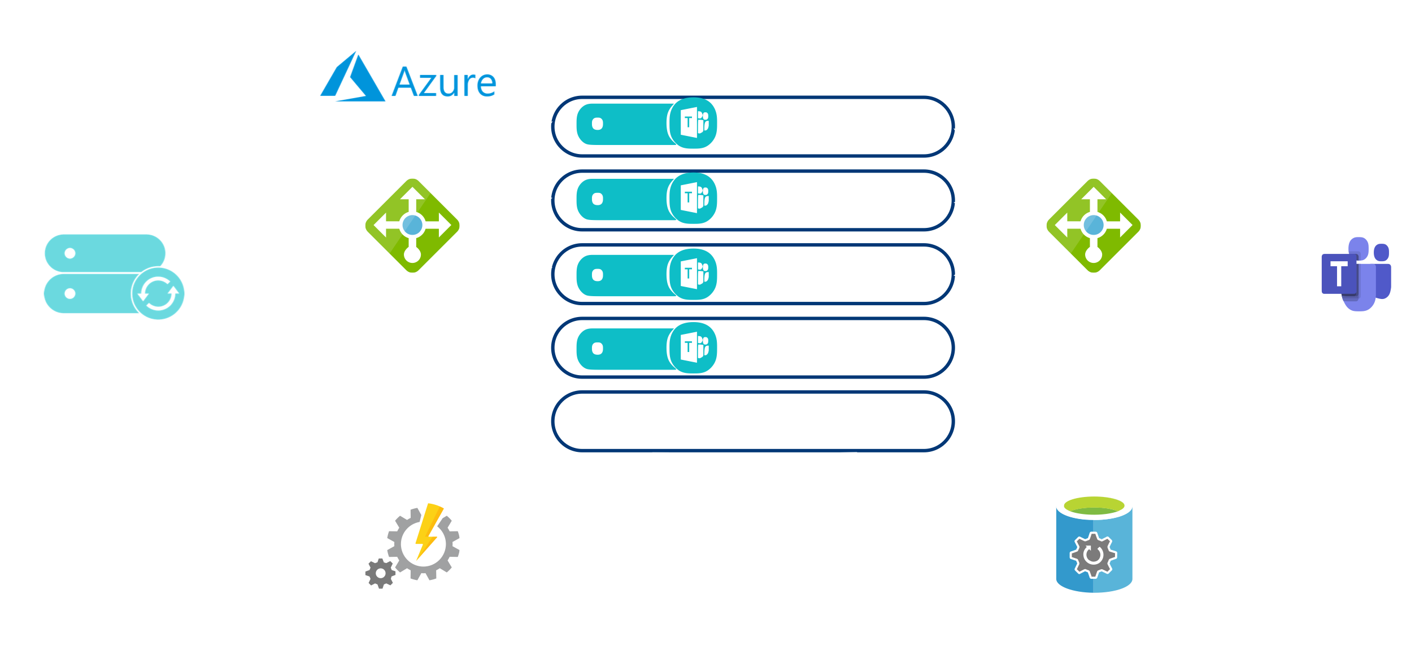
Teams Connector (Optional) for Self-Hosted Deployments

Slide 18
Customization at the core

Slide 19




Infinity | Customizing The Video Experience
Native Apps and
Self-Service Branding
Extending with Plugins
Pexip APIs
Level 1 Customization
Pexip Web Apps are fully open source and can be customized using modular, lightweight plugins
Sample application customizations include ad-hoc SMS / email invitations (e.g.Twilio), pre-defined dial-out to interpreter services, automated dialing to SIP endpoints, and many more
Pexip developer support can be purchased as an add-on
Web app supports code-free custom branding through the Pexip Branding Portal
Level 2 Customization
Fully supported APIs allow your organization to manage nearly every aspect of the video visit experience
Pexip video can be embedded in numerous workflows, including:
Web Pages
Bots
Scheduling platforms
Contact Centers
Ideal for organizations with in-house or established development relationships who wish to implement advanced workflows
Pexip Application Suite
Available, fully supported, and free for use including iOS, Desktop, and web utilities.
Enable many basic video workflows for 1-to-1 and group visits
Can be used with any implementation of Pexip Infinity
Web app supports code-free custom branding through the Pexip Branding Portal

Slide 20




The Pexip API Suite (almost over-simplified)
MANAGEMENT API
Everything you can do from the management node UI
Use for Non-Time-Critical Monitoring and Static Configuration
CLIENT API
Build your own client or app
Use for interactive control or monitoring of conferences
Create different custom experiences for hosts vs guests
EXTERNAL POLICY API**
Actively control conference access
Time Critical service configuration
Can be integrated with other systems to allow for cross-platform event triggers
EVENT SINK API**
Monitor what is happening. JSON events sent over HTTP when conferences start/stop/change and participants join/leave/change
Use for live participant or conference monitoring.
Replaces polling status API (Push, not a Pull)

